Slide 1


SEICHE 2022 Introduction to Arduino Lesson 4 and 5– IDE Essentials
Instructor: Paul Frommeyer
www.paulfrommeyer.com
Corporate Sponsor: DXC Technology

Slide 2
REMEMBER!
Immediately copy the latest lesson folder (Lesson5 today) from your USB flash drive to your hard drive where you previously copied the other flash drive files (probably Documents folder)

Slide 3
Lesson Plan Overview
Lesson 1 – Intro and Setup
[may require 2 classes]
• Introduction to class format
• Overview of lesson plan
• Presentation format (monitor, camera, screen, whiteboard)
• Inventory of Arduino kits
• Inventory of USB drives
• Installation of ESP32 serial port drivers (Windows only)
• Installation of Arduino software
• History of Computing
Lesson 2 and 3 – Laptop operation review
• Control panel/Settings location
• Home directories and folder hierarchy
• Arduino file locations
• Search functions
• Open questions and issues
• History of Computing redux
Lesson 4 and 5 – IDE essentials
• The boards manager
• Setting board type
• Installing Libraries
• Loading example sketches
• Finding and selecting the Arduino USB port
• Uploading a sketch to the microcontroller [Example Sketch#1]
• Basic Arduino sketch (program) structure
• Uploading your own sketch [Example Sketch #2]
• History of Telecommunications and Networking – Part 1
Lesson 6 – DC Electricity Basics and DMM Intro
• Quick review: DC vs AC electric currents
• DC current operation
• Voltage vs Amperage (current)
• LEDs, constant current, and dropping resistors
• Connecting an LED to a microcontroller [Class Sketch#1]
• Ohm’s Law
• Introduction to basic DMM functions and usage
• Series vs parallel circuits
• History of Telecommunications and Networking – Part 2
Lesson 7 – Elementary Components
• Resistors [DMM usage #1]
• Diodes and LED’s
• Capacitors: Electrolytic (polarized) vs non-electrolytic (non-polarized)
• Simplified transistor operation
• Connecting a transistor to a microcontroller [Class Sketch #2]
Lesson 8 – ESP32 External power sources [may require 2 classes]
• Microcontroller board power requirements
• Board power input options
• Components with different voltage requirements
• External power circuit design
Lesson 9 – Connecting LED’s to the ESP32 controller board
• Microcontroller pinouts and diagrams
• Different types of pins
• Analog input
• Digital Input and digital output
Lesson 10 – Connecting smart LED strips
• Simplified serial communication protocols
• One-wire serial communication protocol
• Hardware vs software serial
• WS2812B and Neopixel connections
• External device power design
Lesson 11 – Connecting LCD and Matrix Displays
• The SPI serial protocol
• SPI connections
• SPI device external power design
Lesson 12 – Connecting Sensors [Time permitting]
• I2C serial protocol
• I2C connections
• I2C sensor board power design and external power
Lesson 13 – Connecting other sensors [Time permitting]
• Connecting buttons
• Connecting potentiometers
• Reading buttons
• Reading potentiometers

Slide 4
Lesson 4 and 5 – IDE Essentials
The Arduino IDE
The Boards Manager – Adding a Board
The Library Manager – Installing Libraries
Selecting a board
Accessing example sketches
Finding and selecting the Arduino USB port
Uploading a sketch to the microcontroller [Example Sketch#1]
Basic Arduino sketch (program) structure
Loading our own sketches
History of Telecommunications and Networking

Slide 5
Lesson 4 and 5 – Arduino IDE
IDE stands for “Integrated Development Environment”
A single application can perform all operations needed to program one or more boards
Creation of programming code (C++ for Arduino)
Preparing (compiling) code for upload to a board
Installing and selecting software Libraries which add operations and functionality created by others
Provide basic communications with a board
Uploading code (sketches)
Watching and interacting with the board (Serial Monitor)

Slide 6
The Boards Manager
To know how to prepare (compile) software for and talk with (communicate via USB or RS-232) a board, the Arduino IDE needs a hardware definition for each board to be programmed
Board definitions are handled by the “Boards Manager”
The Boards Manager itself uses URLs to locate board definitions on the Internet, usually provided by the manufacturer
URLs are entered in Preferences
The Boards Manager itself is accessed from the Tools menu
Let’s make sure everything is set up correctly for our HelTec WiFi Kit 32 board with its ESP32 microprocessor…

Slide 7
Boards Manager – Adding A Board
ADD A BOARD #1
Find the URL for the new board
Open Preferences
Add the board
Multiple boards with commas, no space
Filesystem browsers
Click “OK” to close
Heltec WiFi Kit 32 board definition URL (from the Heltec website)
https://github.com/Heltec-Aaron-Lee/WiFi_Kit_series/releases/download/0.0.5/package_heltec_esp32_index.json

Slide 8
Boards Manager – WiFi Kit 32
ADD A BOARD #2
Open Boards Manager under “Tools” menu
Enter “Heltec” in search menu
Click “Install” to install the board definitions for all Heltec ESP32 boards, including the WiFi Kit 32

Slide 9
The Library Manager
A library is a collection of software written by others which performs a specific function or related functions
Libraries allow us to use code written by others in our own projects
In the Arduino IDE, the Library Manager handles the selection and installation of libraries
Libraries are board-specific, so you must have the proper board definition(s) installed first, before you can install libraries for that board
The Library manager is accessed from the Sketch menu
Let’s make sure everything is set up correctly for our HelTec WiFi Kit 32 board with its ESP32 microprocessor…

Slide 10
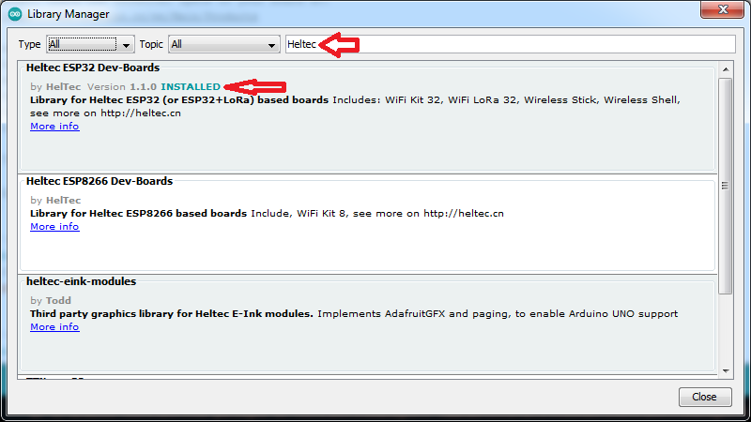
Library Manager – WiFi Kit 32
ADD A LIBRARY
Open “Manage Libraries” under “Include Library” in Sketch menu
Enter “Heltec” in seach box
Install the Heltec ESP32 Dev-Boards library

Slide 11
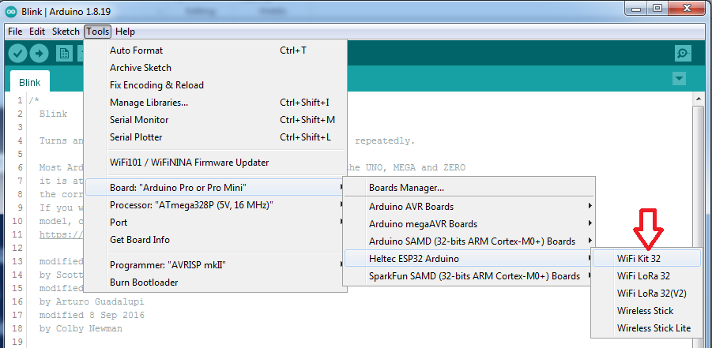
Selecting A Board
Return to the Board menu under the Tools menu
Navigate to Heltec ESP32 Arduino
Select WiFi Kit 32

Slide 12
Accessing Example Sketches
File->Examples
At the very bottom of the menu you should see all the relevant examples for the WiFi Kit 32 included with the Heltec ESP32 library just installed
As you can see, there are dozens upon dozens available
Typical for all boards
What makes “plug and play” Arduino use possible
And thus this class

Slide 13
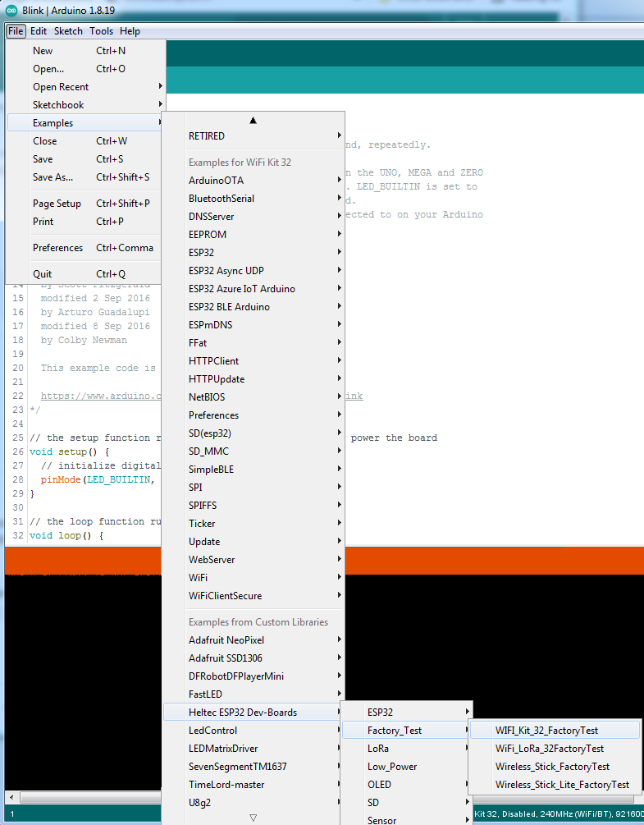
Preparing a Sketch
Find the WiFi_Kit_32_FactoryTest example sketch under Heltec ESP32 DevBoards sub-menu
Click on the “VALIDATE” check mark icon
This will compile the sketch and check for errors prior to upload (this step is optional)
X

Slide 14
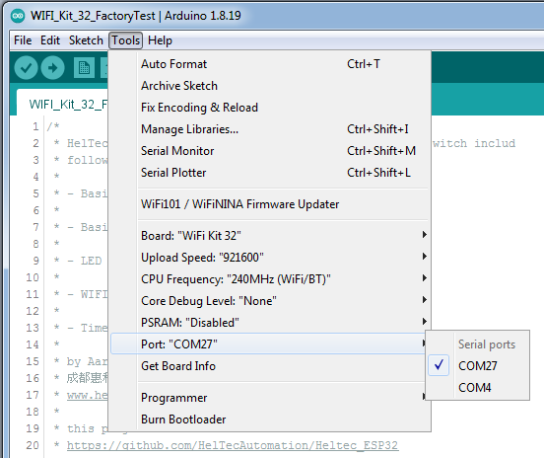
Finding and Setting the USB Port
WINDOWS
Use Device Manager to identify the USB port
The port will change with each connect/disconnect of the board
KUBUNTU
Port should always be /dev/ttyUSB0
The port will not change with connect/disconnect
You can use Konsole to verify the port presence ls /dev/tty*
Note: Late breaking information not included in Lesson4

Slide 15
Adjusting Port Speed
CAUTION
The SiL CP2102 USB-to-Serial chip used on all ESP32 boards has a known bug that can cause the serial port speed to randomize when the board is connected
Infrequent with Windows
Often with all Linux distros
If you get an upload failure
Recheck port setting
Retry the upload with the next highest speed
Lather, rinse, repeat until success
Suggested initial try order: 921600, 512000, 115200
Note: This slide accidentally omitted from Lesson4

Slide 16
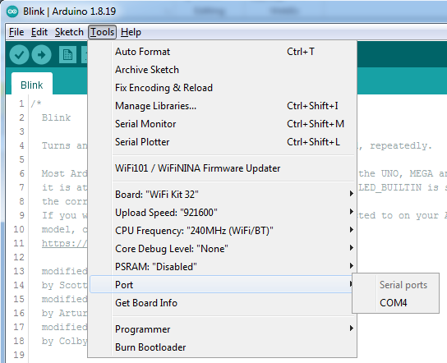
Uploading a Sketch
Ensure you have selected the correct port (and speed!) for your currently plugged in board
Click on the “UPLOAD” arrow icon
Lights should flash on your board
Once upload is finished, the sketch will immediately run
If you get an error, recheck board, port and speed settings (refer to preceding slides)

Slide 17
Let’s load our own sketch!
File menu->Open
Navigate to the“ClassSketch1.ino” file in the Lesson5->ClassSketch1 folder you copied from your USB drive at the beginning of class
The sketch will open in the IDE
Click on the “UPLOAD” arrow icon
Once compile and upload are finished, the sketch will immediately run
Windows
Kubuntu
Note
Sketches live in folders with the same name

Slide 18
Lessons 1-5 Skills Review
At this point you should now be able to:
Connect your WiFi Kit 32 board to your computer
Have the computer recognize the board
Identify the board serial port (Device Manager if Windows)
Start the Arduino IDE
Configure and select board type in the Board Manager
Configure and select matching library in the Library Manager
Select the serial port and port speed in the IDE
Load an example sketch or your own sketch
Validate (compile) a sketch
Upload a sketch to your board
You can now start experimenting with different sketches from the WiFi Kit 32 library examples!

Slide 19
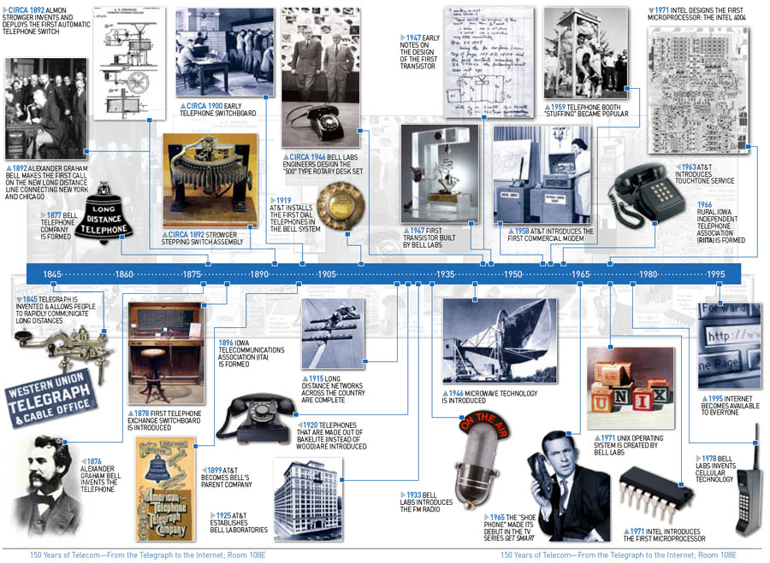
History of Telecommunications Part 1
The Telegraph
The Analog Telephone
Radio (AM then FM)
Automated dialing
Digital audio
Dedicated computer links (DDS)
The first modem

Slide 20
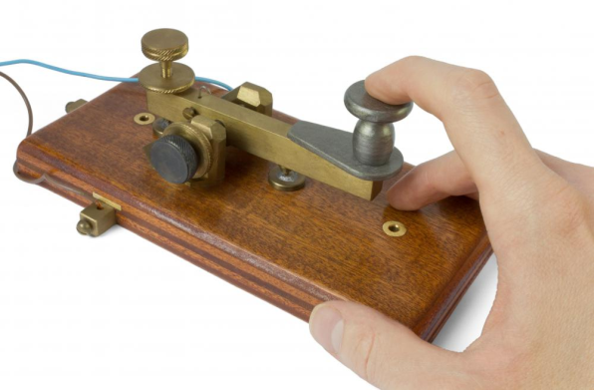
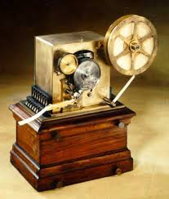
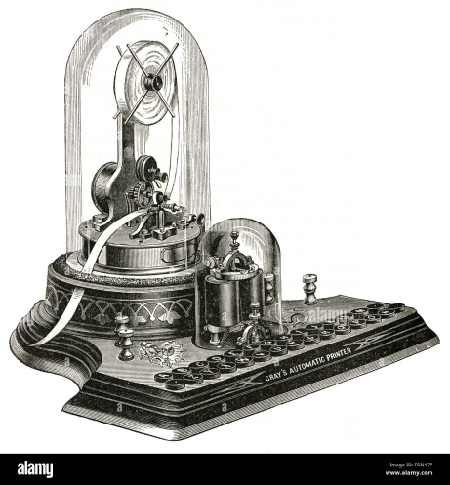
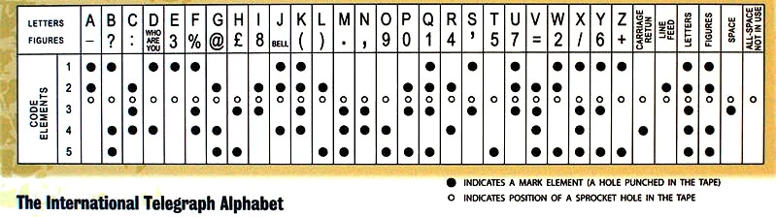
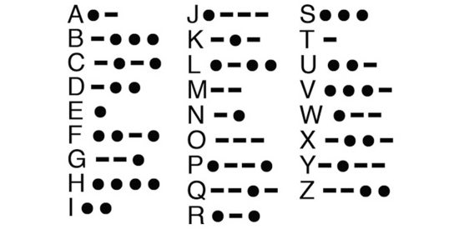
The Telegraph
The archetype of this device was the Morse system, invented by Samuel Morse in 1838, using a single wire.
Morse system used Morse Code, a cipher which translated letters into long and short electrical pulses sent with a make/break signalling key
These pulses could be received as clicks or as audio beeps (see Radio section)
There were also optical telegraphs
The first printing telegraphs would punch holes in paper tape
Later printing telegraphs used letters generated by special codes (Baudot, ITA2)
Electrical telegraphy can be considered to be the first example of electrical engineering,[5] and was used by the emerging railway companies to develop train control systems that minimised the chances of trains colliding with each other.
Morse Code

Slide 21
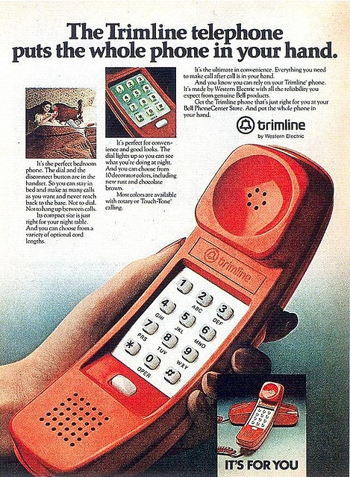
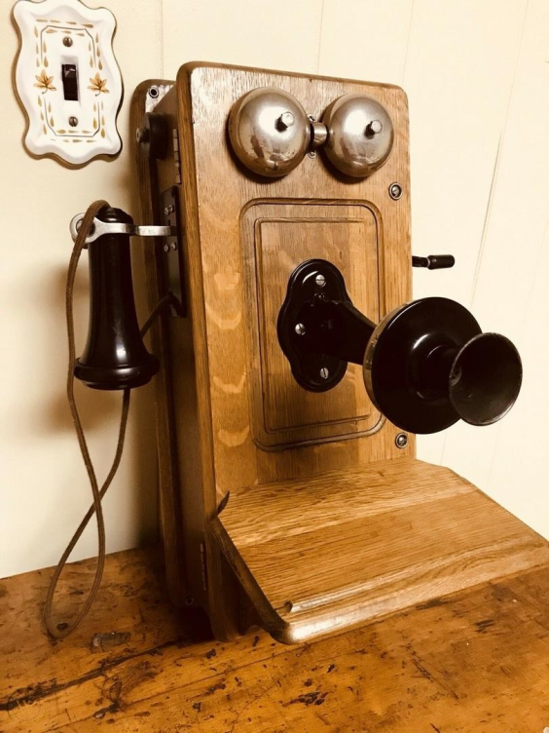
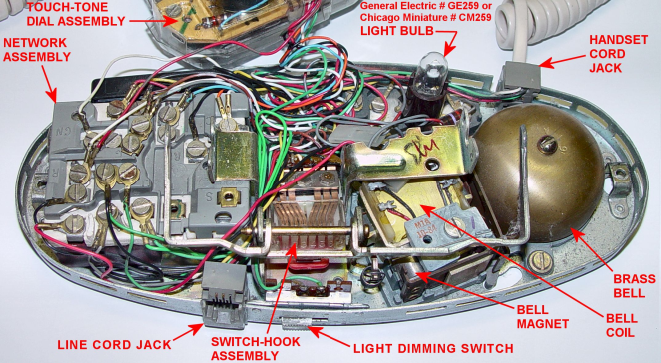
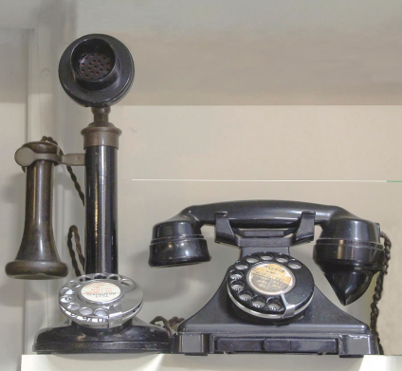
The Analog Telephone
Invented by Alexander Graham Bell,
Initially, no station originated dialing – required operators to place and deliver calls
Phone sets had cranks to signal the operator
Analog phones use a “hybrid” to allow talk and hearing on 2 wires
Was a landmark invention in human communication
Hybrid
Switch
Hook
Dial
Ringer
Parts of an analog telephone

Slide 22
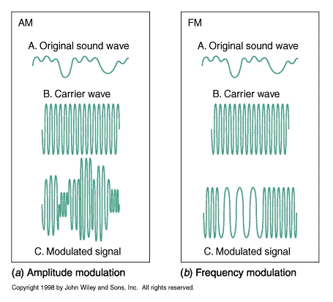
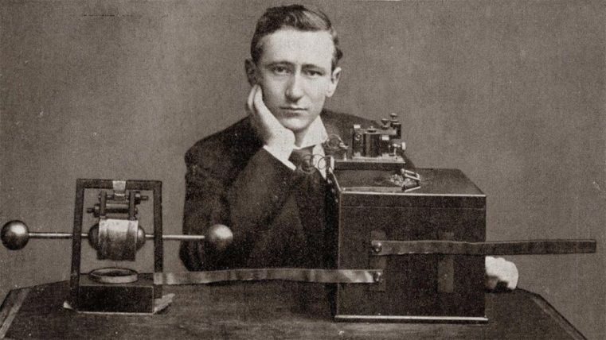
Radio
Guglielmo Marconi sent and received first radio signal in Italy in 1895
Initially, radio used Morse code to modulate (interrupt) spark gap transmitters
The person generally credited as the primary early developer of AM technology is Canadian-born inventor Reginald Fessenden
AM radio is monophonic (only one audio channel)
The development of radio was made possible by the invention of vacuum tubes, which permitted amplification of weak electrical signals
Frequency Modulation, with amazing clarity and no static, was invented in 1933 by American engineer Edwin Armstrong. However, it’s adoption was slowed by RCA for over 30 years and it did not come into widespread use until the 1960’s with stereo broadcasting
Guglielmo Marconi
AM vs FM

Slide 23
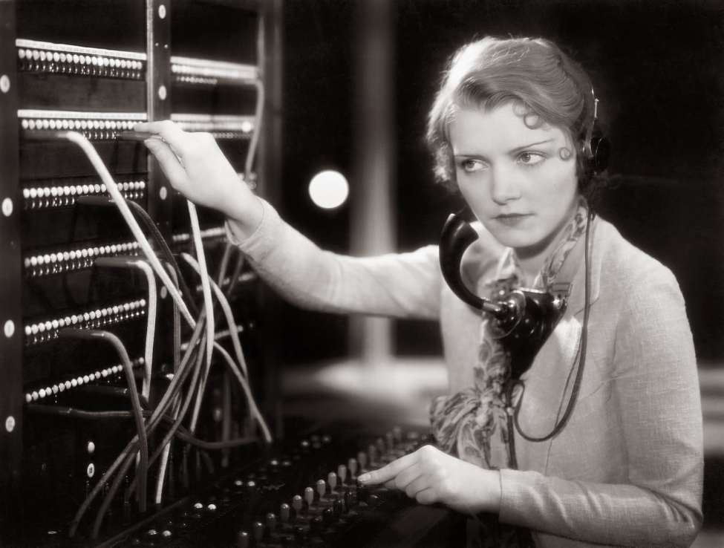
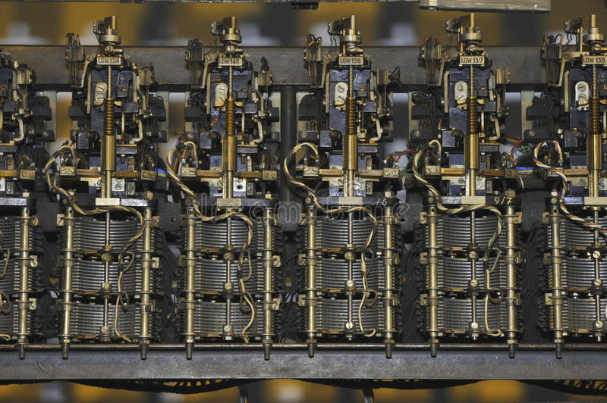
Automated Telephone Dialing
Originally, all calls were manually switched through operator’s patch cord consoles
The Strowger switch is the first commercially successful electromechanical stepping switch telephone exchange system, developed by the Strowger Automatic Telephone Exchange Company in 1891
Automatic switches allowed end-station dialing, initially using a rotary dial
The transistor age allowed the development of touch-tone dials, which used Dual-Tone Multi-Frequency (DTMF) in-band signalling for dialing
Traditional telephone operator’s console
Telephone rotary stepper switches

Slide 24
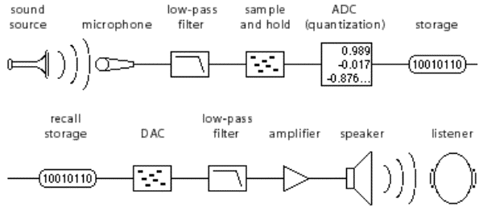
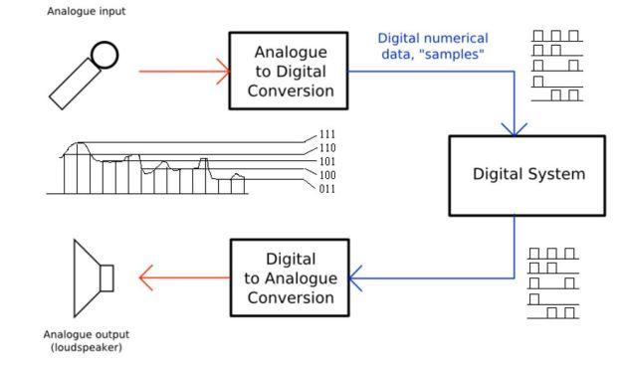
Digital Audio
Digital audio is a representation of sound recorded in, or converted into, digital form. In digital audio, the sound wave of the audio signal is typically encoded as numerical samples in a continuous sequence.
Primarily invented by Claude Shannon
Pulse-code modulation (PCM) is a method used to digitally represent sampled analog signals. It is the standard form of digital audio in computers, compact discs, digital telephony and other digital audio applications.
US telephone system (AT&T) began using PCM in 1961
Quantization
Complete Signal Flow

Slide 25
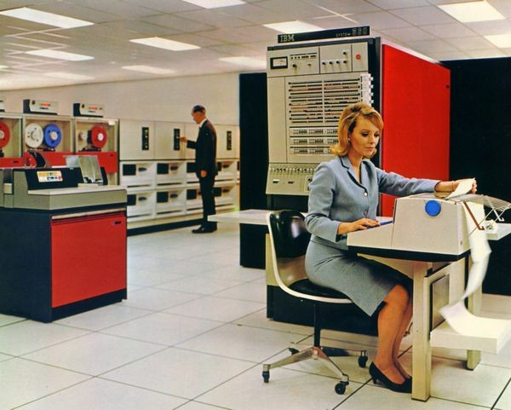
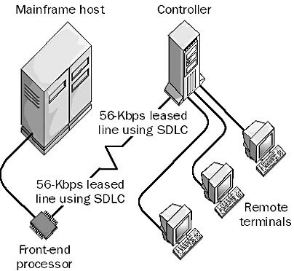
Dedicated Computer Links
AT&T offered dedicated point-to-point digital circuits for use by mainframe computer systems
Commonly called DDS for Digital Data Service
These were all low-speed circuits of 56Kbps or less
They were used primarily with IBM systems which used a method called SDLC to place remote terminals
Other systems required a dedicated link per terminal
S/360 CPU and Peripherals
Remote terminals with SDLC

Slide 26
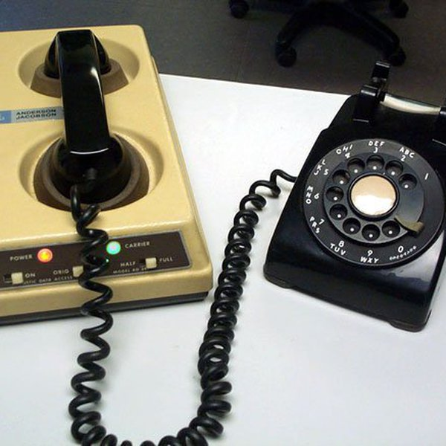
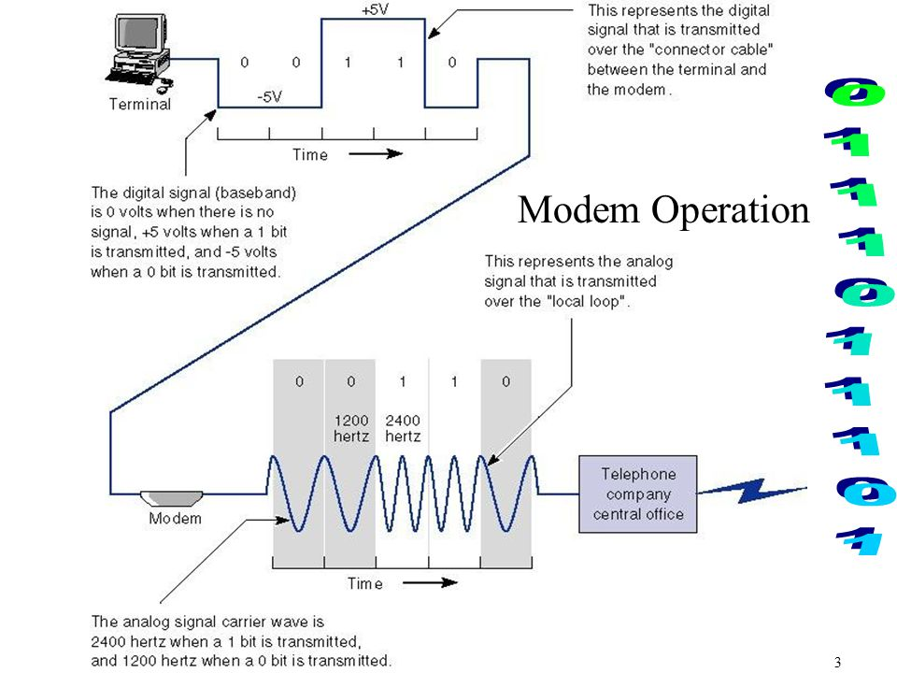
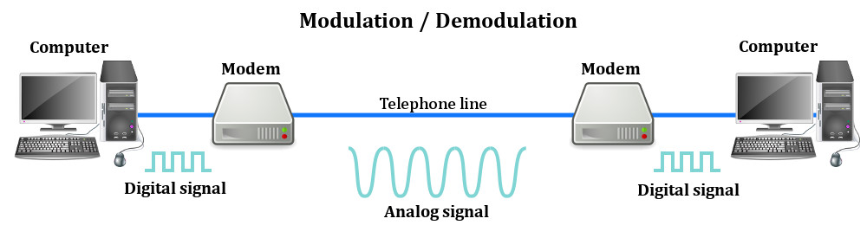
The First Modem
A modem is a MODulator dEModulator, which changes digital signals into audio signals or vice-versa
Permits two-way digital communication between two computers over ordinary phone lines
The original modems were owned by AT&T and used the Bell 212A standard, which was 110bps and required the use of an “acoustic coupler” that held the handset
With the AT&T breakup in the 1980’s, faster modems were developed up to 56Kbps, close to the theoretical Shannon limit for speed over a 4K bandwidth phone line
Modem technology evolved to support Digital Subscriber Line connections (DSL) at speeds up to 50Mbps

Slide 27
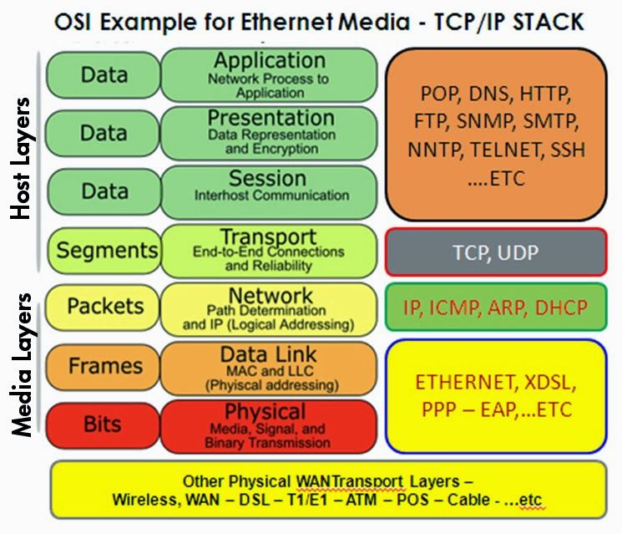
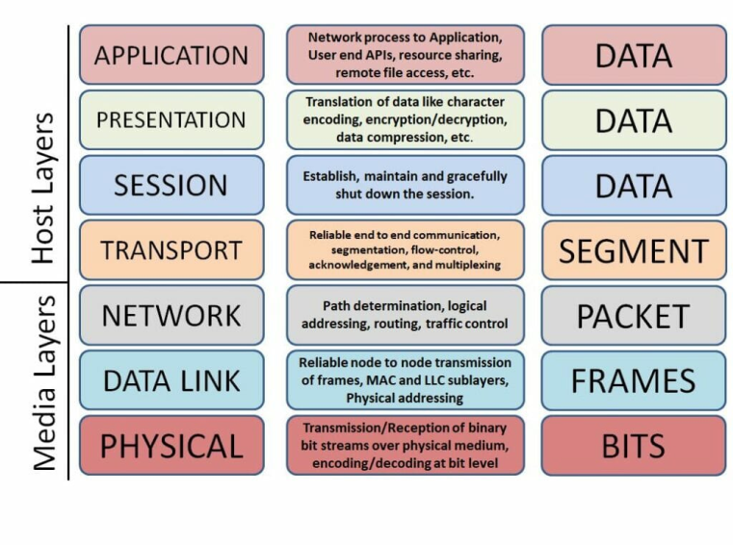
The OSI/ISO Layered Network Model
In a Quora post asking about the purpose of the OSI model, Vikram Kumar answered this way:
“The purpose of the OSI reference model is to guide vendors and developers so the digital communication products and software programs they create will interoperate, and to facilitate clear comparisons among communications tools.”
While some people may argue that the OSI model is obsolete (due to its conceptual nature) and less important than the four layers of the TCP/IP model, Kumar says that “it is difficult to read about networking technology today without seeing references to the OSI model and its layers, because the model’s structure helps to frame discussions of protocols and contrast various technologies.”
If you can understand the OSI model and its layers, you can also then understand which protocols and devices can interoperate with each other when new technologies are developed and explained.
Source: Network World

Slide 28
Formal End of Lesson 4 and 5
In next week’s exciting episode
Quick review: DC vs AC electric currents
• DC current operation
• Voltage vs Amperage (current)
• LEDs, constant current, and dropping resistors
• Connecting an LED to a microcontroller [Class Sketch#2]
• Ohm’s Law
• Introduction to basic DMM functions and usage
• Series vs parallel circuits
History of Telecommunications – Part 2
The OSI/ISO Networking Model Redux
Local Area Networks (LANs)
Wide Area Networks (WANs)
Wireless LAN (WiFi)
Cellular data networks
TCP/IP and the OSI model
The Rise and Fall of the Internet
Don’t forget to return your USB drives!

